Slide 1
Sentiment Analysis on Amazon
Book Reviews using PySpark
TEAM B
Nitin Sunil Chaube
Dharani Guntupalli
Akshaya Botla

Slide 2



PROBLEM STATEMENT
With the rapid increase in online reviews, analyzing customer sentiments has become crucial for businesses.
In this project, we aim to build a Big Data Sentiment Analysis System using PySpark on the Amazon Book Reviews dataset (10.3M users reviews).
This project will demonstrate scalable data processing, machine learning-based sentiment classification, and the ability to scale up & scale out.

Slide 3







OBJECTIVES
Understand the structure and characteristics of Amazon Book Reviews data.
Preprocess large-scale textual data using PySpark for effective modeling.
Perform Exploratory Data Analysis (EDA) to uncover patterns and insights.
Develop Machine Learning models for sentiment classification.
Evaluate model performance on large-scale data.
Scale up & Scale out using PySpark to demonstrate Big Data handling.
Draw conclusions and provide recommendations based on analysis.

Slide 4
DATA OVERVIEW
Dataset: Amazon Book Reviews dataset (10.3M user’s reviews)
File Format : JSONL, converted to CSV for structured analysis
Key Features : review_id (Unique identifier), user_id (Reviewer’s ID), rating (Star rating from 0 to 5), text (Review content), verified_purchase (Boolean, whether the purchase was verified)
Target Variable : “Rating” which is used for Sentiment (Positive, Negative) analysis.

Slide 5









DATA PREPROCESSING
Handling Missing Values : Removing or imputing missing data.
Removing Duplicates : Using PySpark’s dropDuplicates().
Under sampling high class values
Text Cleaning : Removing punctuation, stopwords, and lowercasing text.
Feature Engineering :
a) Sentiment Labeling: Converting ratings into sentiment categories.
b) Review Length: Extracting text length.

Slide 6
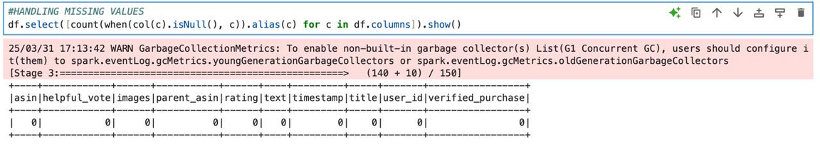
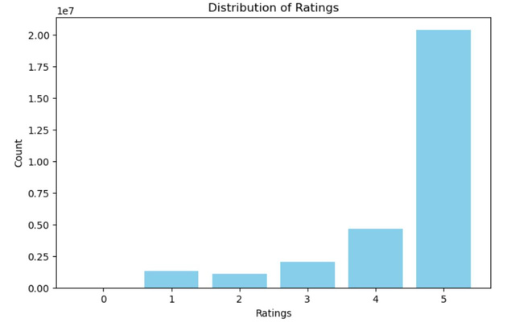
EXPLORATORY DATA ANALYSIS (EDA)
Step 1: Handling Missing values
Step 2: Distribution of Ratings

Slide 7
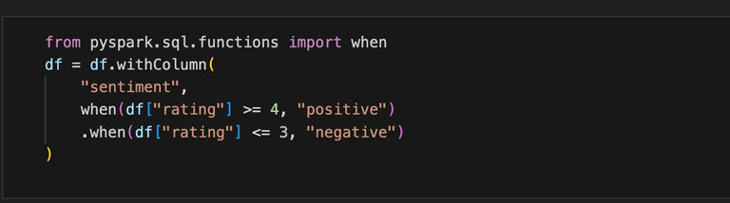
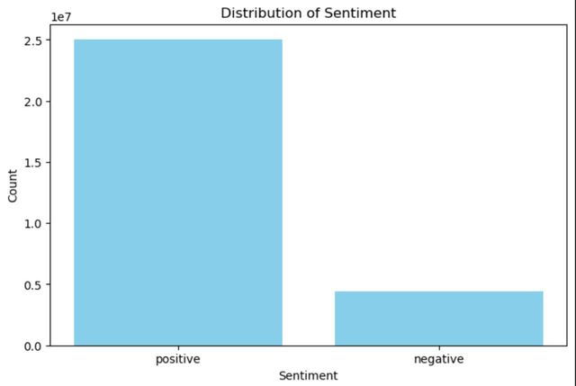
FEATURE ENGINEERING
SENTIMENT LABELING

Slide 8
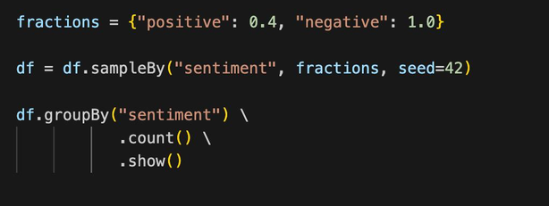
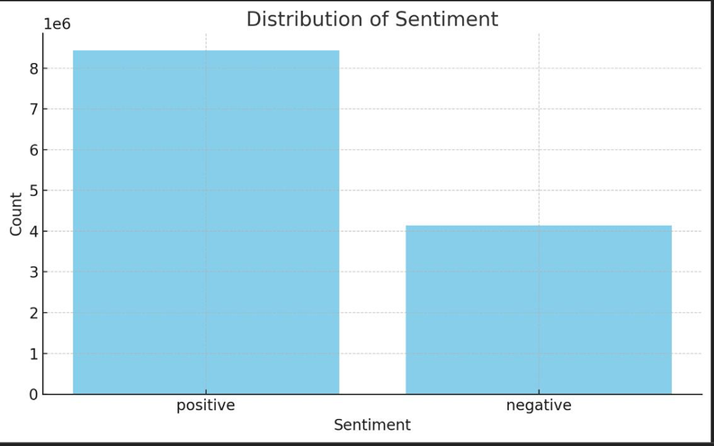
FEATURE ENGINEERING
Downsampling positive sentiments

Slide 9
MACHINE LEARNING MODELS
Traditional ML Models :
- Logistic Regression
- Random Forest
Pipeline Implementation:
- TF-IDF for text vectorization.
- Model training in PySpark MLlib.

Slide 10
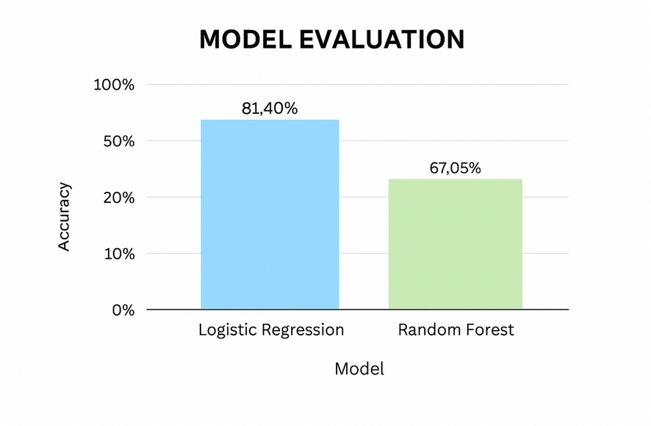
MODEL EVALUATION

Slide 11
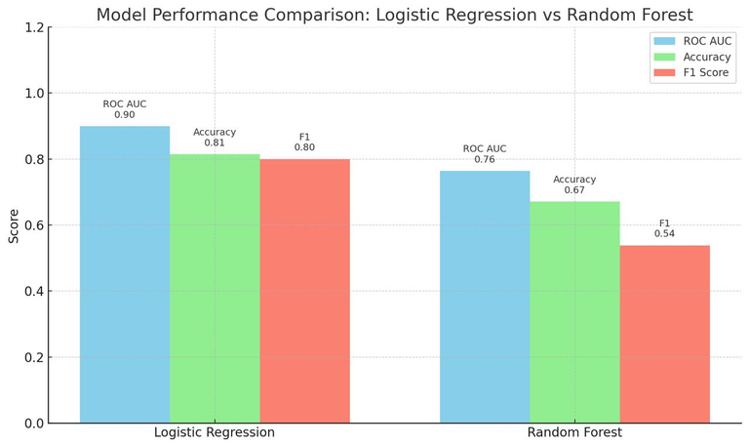
MODEL PERFORMANCE EVALUATION

Slide 12
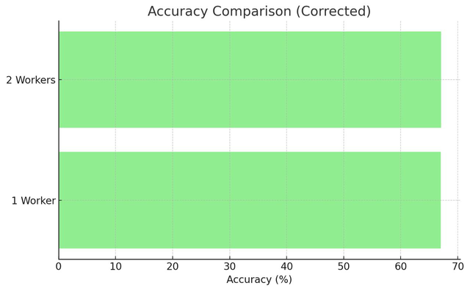
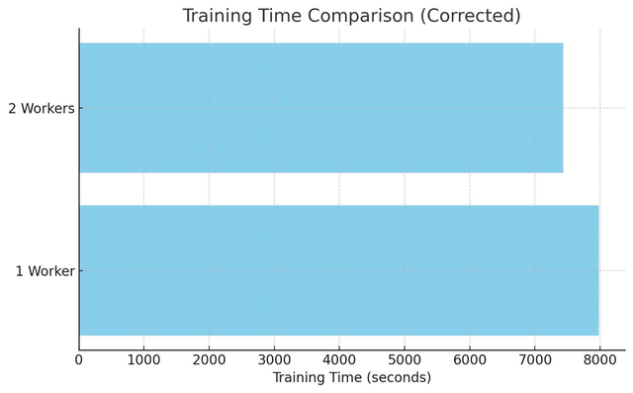
SCALING OUT

Slide 13
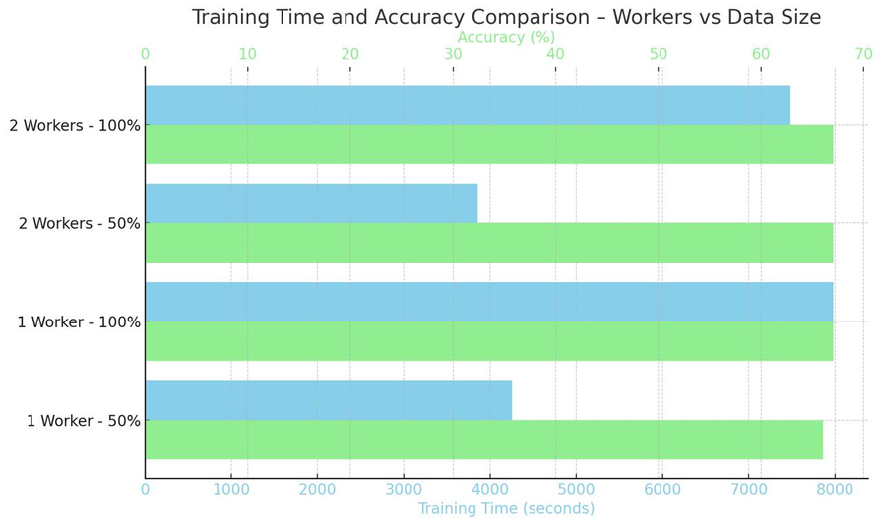
SCALING IMPACT OF SCALING UP

Slide 14
CONCLUSION
Our PySpark-based sentiment analysis system efficiently processed over 10 million Amazon book reviews, showcasing the power of scalable big data tools.
The machine learning models demonstrated promising accuracy, with Logistic Regression outperforming Random Forest.
Preprocessing, downsampling, and feature engineering significantly improved model effectiveness.
Scaling techniques (both up and out) proved essential in handling large volumes of unstructured text.
This project highlights how Big Data and NLP can drive actionable insights from user-generated content.

Slide 15

THANK YOU

